Slide 1
Lecture 6
While Loop

Slide 2
Loops
Loops repeat a statement a certain number of times, or while a condition is fulfilled. They are introduced by the keywords while, do, and for.Loops repeat a statement a certain number of times, or while a condition is fulfilled. They are introduced by the keywords while, do, and for.

Slide 3
Iterative Method
Normally to repeat a statement multiple number of time we can repeat that statement but this is not an efficient way.
Statement 1;
Statement 1;
Statement 1;
Statement 1;
Statement 1;
Statement 1;

Slide 4
Iterative Method example
// C++ program to illustrate need of loops #include <iostream> using namespace std; int main() { cout << "Hello World\n"; cout << "Hello World\n"; cout << "Hello World\n"; cout << "Hello World\n"; cout << "Hello World\n"; cout << "Hello World\n"; cout << "Hello World\n"; cout << "Hello World\n"; cout << "Hello World\n"; cout << "Hello World\n"; return 0; }
Output
Hello World Hello World Hello World Hello World Hello World Hello World Hello World Hello World Hello World Hello World

Slide 5
While Loop
A while loop statement repeatedly executes a target statement as long as a given condition is true.
while(condition) {
statement(s);
}

Slide 6
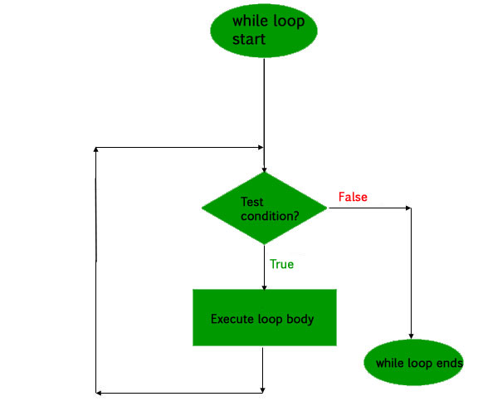
While Loop Flow Chart

Slide 7
While Loop example
// C++ program to illustrate for loop
#include <iostream>
using namespace std;
int main()
{
// initialization expression
int i = 1;
// test expression
while (i < 6)
{
cout << "Hello World\n";
// update expression
i++;
}
return 0;
}
Output
Hello World Hello World Hello World Hello World Hello World

